Slide 1
Histology of urinary system
By: M. G. Hammad
Notes:
Histology of urinary system

Slide 2
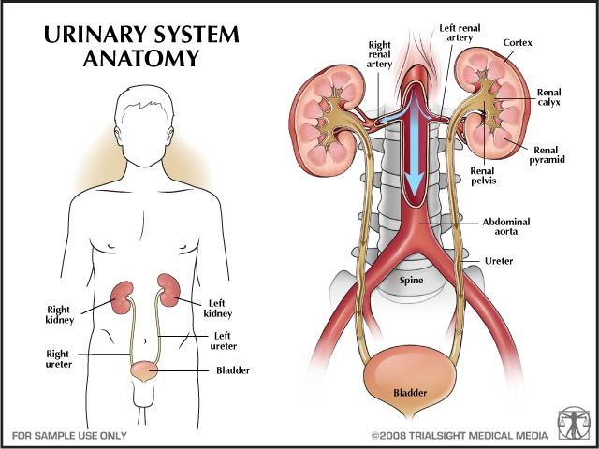
Introduction anatomical review
Renal system formed of: 2kidneys, 2 Ureters, Bladder, Urethra.
Its main functions are:
Filters cellular wastes from blood.
Reabsorption water and solutes.
Excretion of wastes and excess water as urine.
Notes:
Histology of urinary system

Slide 3
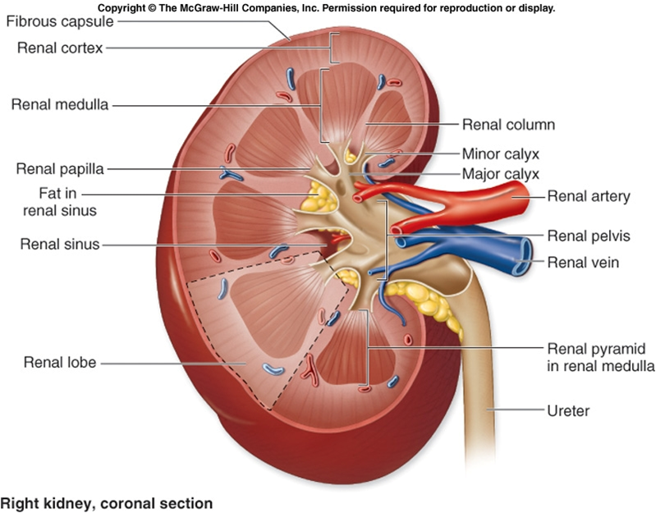
kidney
Each kidney has:
Lateral border
Medial border, hilum.
Renal pelvis.
Major calyces.
Minor calyces.
Renal sinuses.
Notes:
Histology of urinary system

Slide 4
Histological structures of kidney
Outer layer: cortex.
Inner zone: Medulla
Renal pyramid (8-15).
Renal column.
Renal lobe
Notes:
Histology of urinary system

Slide 5
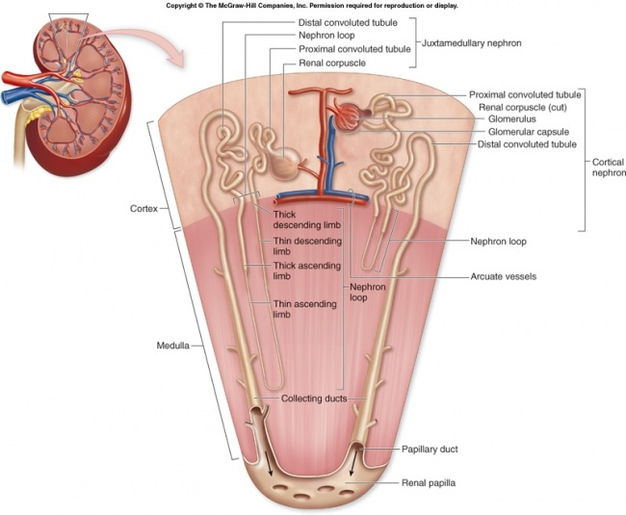
The functional unite of kidney
The nephron:
About 1 to 1.4 million nephron.
It's Composed of:
Renal corpuscle.
Proximal convoluted tubule.
Nephron loops ( loop of Henle ).
Distal convoluted tubules.
Collecting tubules.
N.B: collecting tubules collecting ducts
Calyces ureter
Notes:
Histology of urinary system

Slide 6
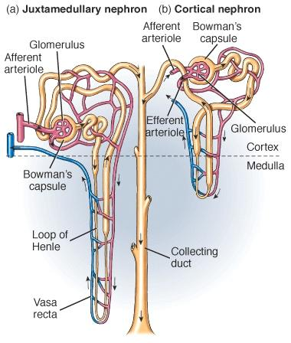
Types of nephron
Cortical nephron:
Completely on the cortex.
Juxtamedullary nephron:
Close to medulla, has long loops on the medulla.
Notes:
Histology of urinary system

Slide 7
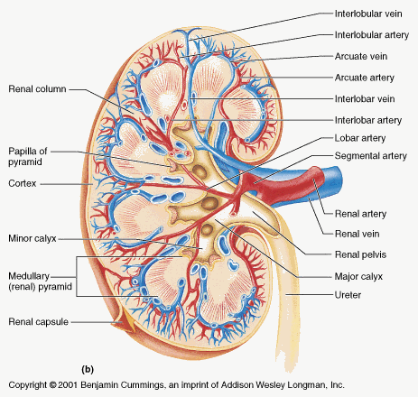
Blood circulation through the kidney
Kidney vessels named according to their location and shape.
Renal artery
Segmental arteries
Interlobar arteries
Arcuate arteries
Interlobular arteries
Afferent arterioles
Efferent arterioles
Pretubular capillaries
Vasa recta
Venules. From here the same as artery
Renal sinus
C.M junction
Notes:
Histology of urinary system

Slide 8
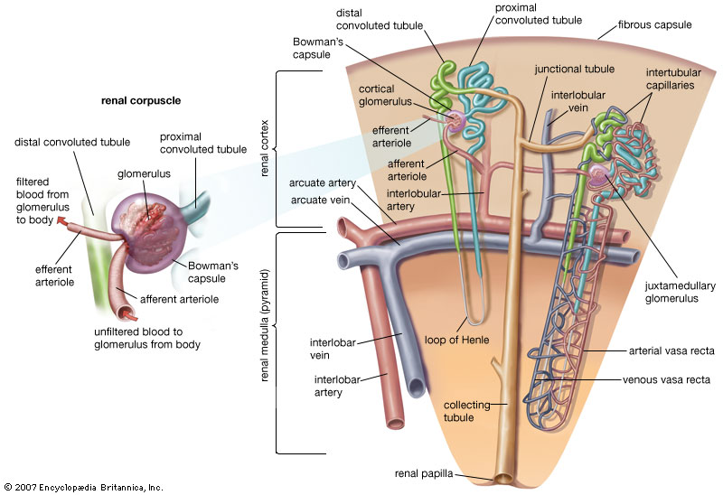
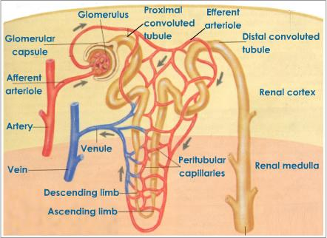
Notes:
Histology of urinary system

Slide 9
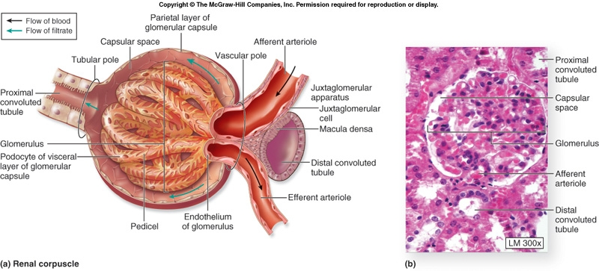
Structures of nephron Renal corpuscle:
Lies at the beginning of nephron.
About 200 micron.
Formed of:
Glomerulus: loose knot of capillaries.
Bowman’s capsule: double-walled epithelial capsule.(visceral and parietal layers).
Between the 2 layers of capsule lies capsular space.
Each corpuscle has:
Vascular pole.
Renal or tubular pole.
Notes:
Histology of urinary system

Slide 10
Structures of Renal corpuscle
Parietal layer of bowman’s capsule: simple squamous epithelium, rests on basal lamina & reticular fibers.
At the tubular pole, the epithelium become simple cuboidal epithelium.
Visceral layer of bowman’s capsule: the cells modified to podocytes cells.
Podocytes cells:
Primary processes.
2nd processes (foot or pedicels).
Mesangial cells:
Fill the area between capillaries lack of podocytes.
They are 2 types: extra glomerular & glomerular mesangial cells.
Mesangial cells
Notes:
Histology of urinary system

Slide 11
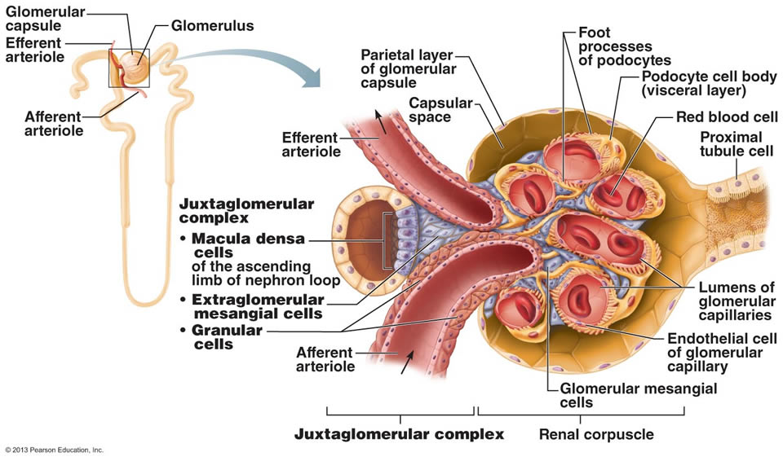
Functions of Mesangial cells
Physical support and contraction.
Phagocytosis.
Secretion (erythropoietin).
Notes:
Histology of urinary system

Slide 12
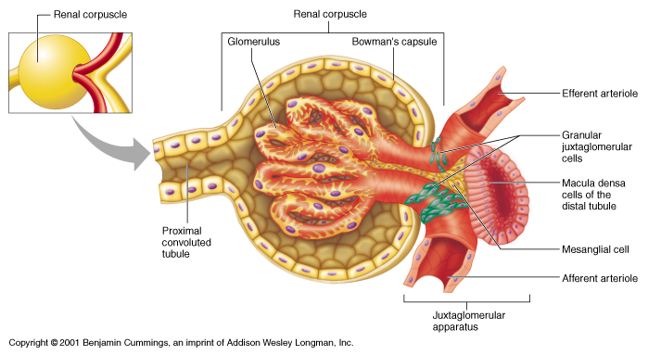
Proximal convoluted tubule
Lies at the tubular pole of R.C.
It is longer than D.C.T .
It is lined by simple cuboidal EPI.
The lumen surface of cells has long microvilli(brush border).
Notes:
Histology of urinary system

Slide 13
Notes:
Histology of urinary system

Slide 14
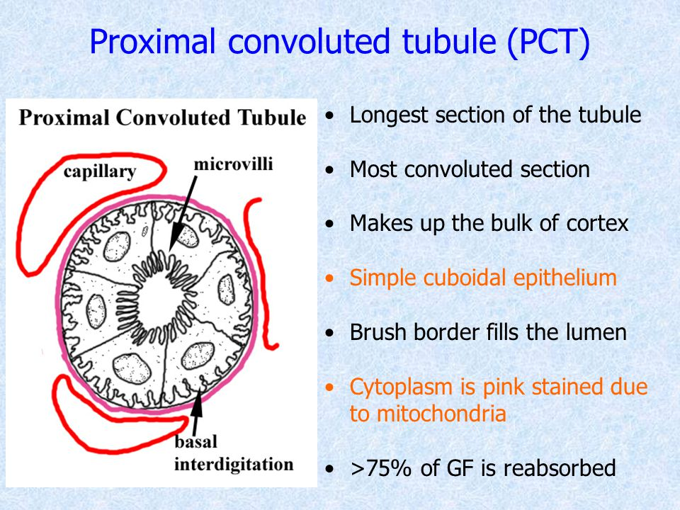
Notes:
Histology of urinary system

Slide 15
Nephron loop (loop of Henle)
U-shaped straight tube.
Consists of descending and ascending limbs.
It is cross from cortex to medulla.
It is lined by simple cuboidal near cortex and simple squamous near medulla.
Notes:
Histology of urinary system

Slide 16
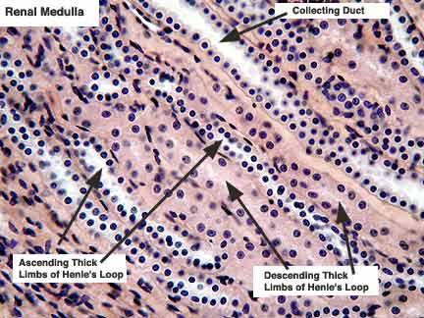
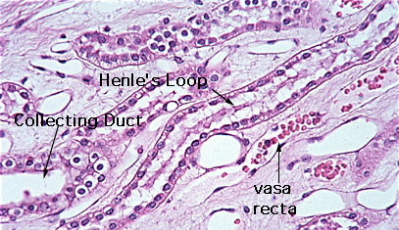
Notes:
Histology of urinary system

Slide 17
To be continue….

Slide 18
Distal convoluted tubule
It is a continuation of thick ascending limb of Henle loop.
Lined by simple cuboidal cells.
Unlike PCT epithelium there is no brush border in these cells.
The cells flatter and smaller than PCT cells.
The lumen of DCT is wider more than PCT.
More nuclei can appear in section of DCT.
It is functions concerning with ion transporting.
Also maintaining acid-base balance.
Notes:
Histology of urinary system

Slide 19
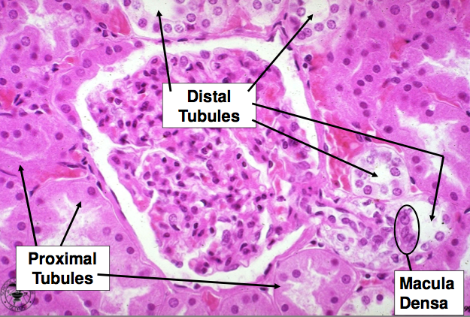
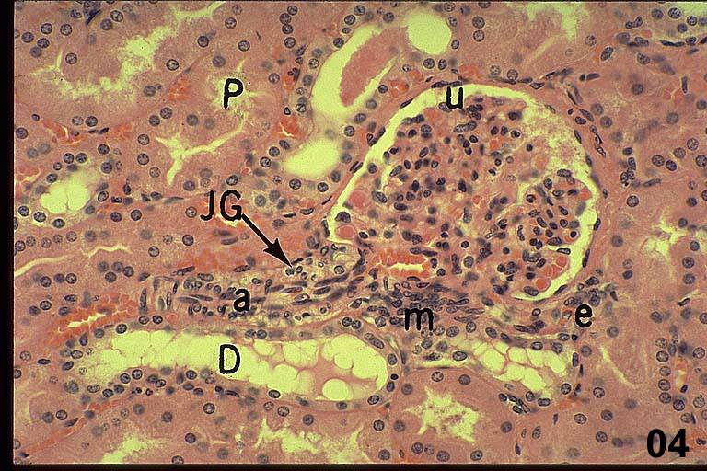
Notes:
Histology of urinary system

Slide 20
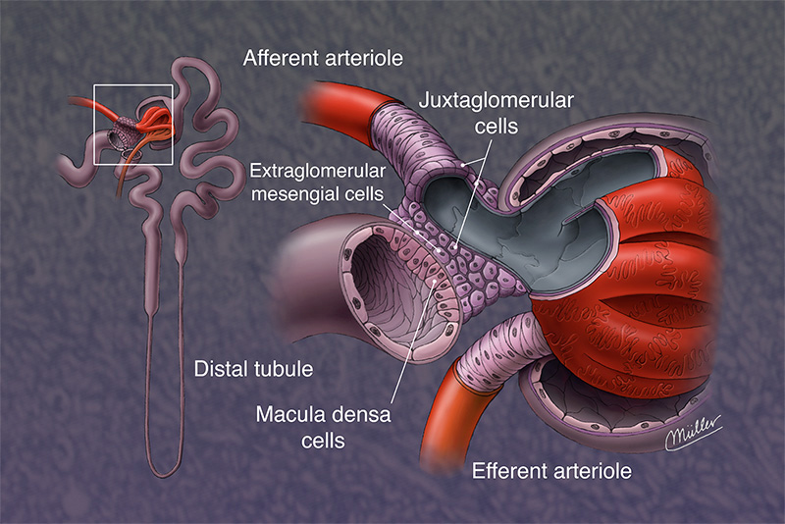
Juxtaglomerular apparatus (JGA)
Lies where the initial straight part of DCT comes in close contact with the vascular pole of RC.
Structures of JGA:
Macula densa: at the point where the DCT touch the arterioles, cells of DCT become columnar & more closely packed, with apical nuclei.
Juxtaglomerular granular cells(JG): adjacent to MD, modified smooth muscle cells of tunica media of arterioles, form secretory phenotype cells with rounded nuclei.
Lacis cells: extra glomerular mesangial cells, has the same functions of glomerular mesangial cells.
2
3
1
Notes:
Histology of urinary system

Slide 21
Function of JGA
Auto regulation of glomerular filtrating rate (GFR).
Control blood pressure within arterioles.
Notes:
Histology of urinary system

Slide 22
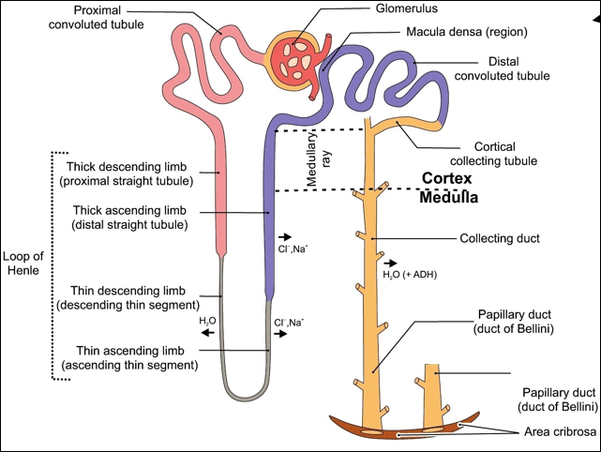
Collecting tubules & ducts: Collecting tubules
The last part of nephron.
Begins at the end of DCT.
Each tubule about 40 micron in diameter.
Lined by simple cuboidal epithelium.
With scanty microvilli.
These cells rest on infolding basement membrane.
Notes:
Histology of urinary system

Slide 23
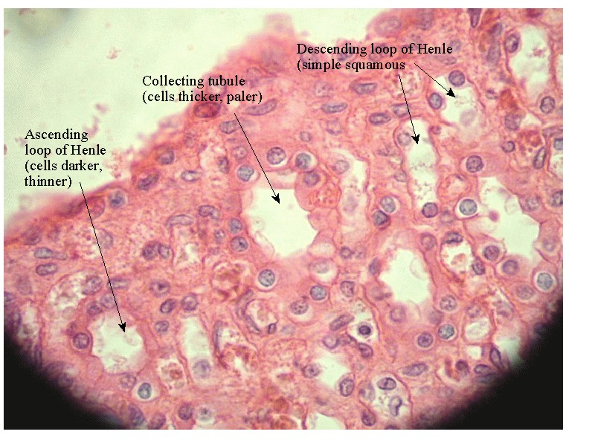
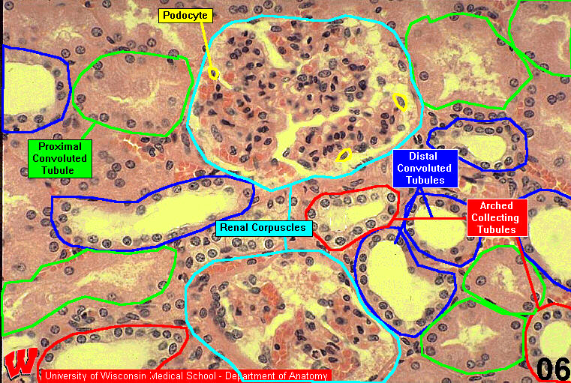
Notes:
Histology of urinary system

Slide 24
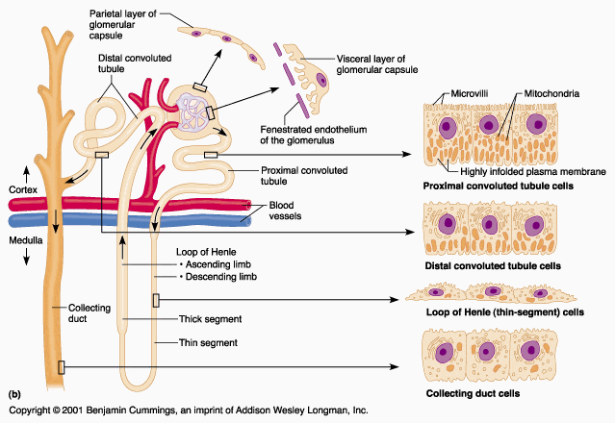
Collecting ducts (CD)
Formed by joining collecting tubules.
Open at the tip of medullary pyramids.
Each tubule about 200 micron in diameter.
The epithelium are more columnar cells
With scanty microvilli.
These cells rest on infolding basement membrane.
Notes:
Histology of urinary system

Slide 25
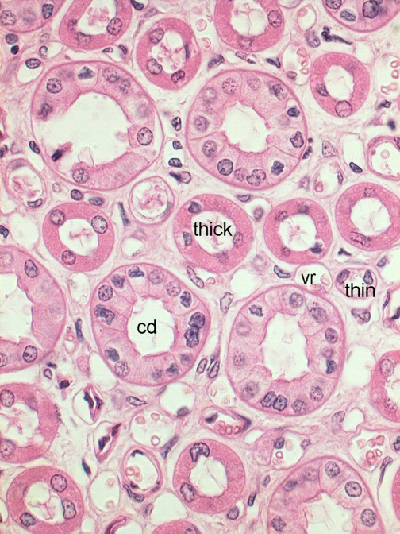
Notes:
Histology of urinary system

Slide 26
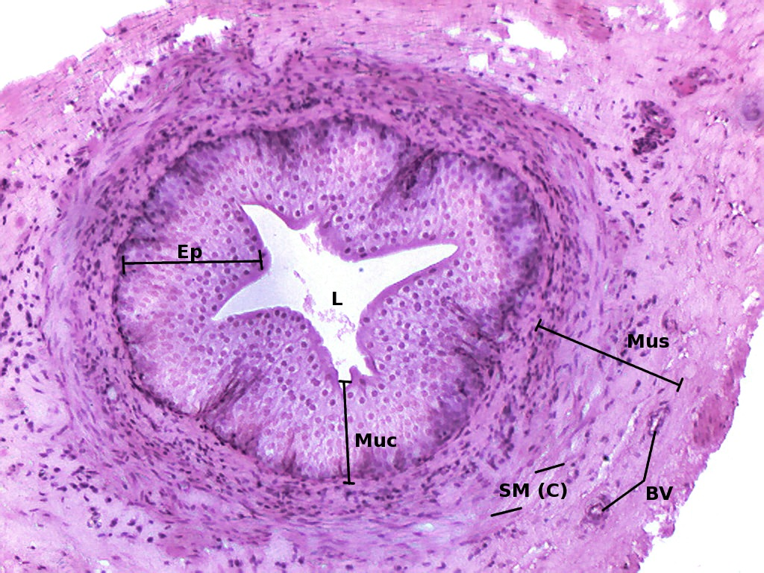
Calyces & renal pelvis & ureter
The walls of these structures become gradually thicker from calyces through ureter to bladder.
The walls formed of:
* Mucosa:
lined by unique transitional epithelium (urothelium).
Surrounded by thick lamina propria & submucosa.
* Muscularis:
Dense sheath of interwoven smooth muscle layers( inner longitudinal, outer circular ).
* Adventitia:
CT containing BV & N
Notes:
Histology of urinary system

Slide 27
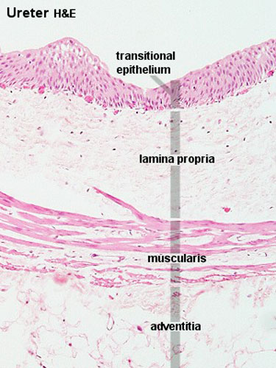
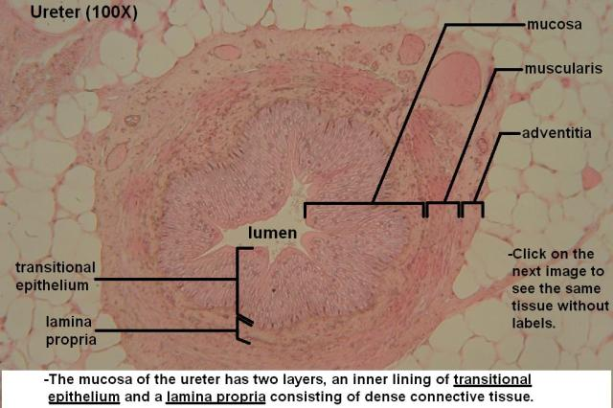
Notes:
Histology of urinary system

Slide 28
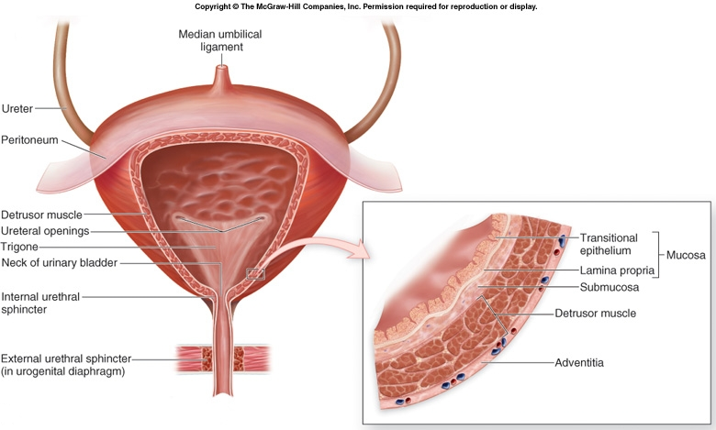
Urinary bladder
Its walls formed of:
* Mucosa:
lined by unique transitional epithelium (urothelium).
Surrounded by thick lamina propria & dens irregular CT of submucosa, these layers highly vascularized.
* Muscularis:
Consists of 3 layers, collectively called detrusor muscle
* Adventitia:
CT , cover all bladder externally except the upper part(serous peritoneum).
Notes:
Histology of urinary system

Slide 29
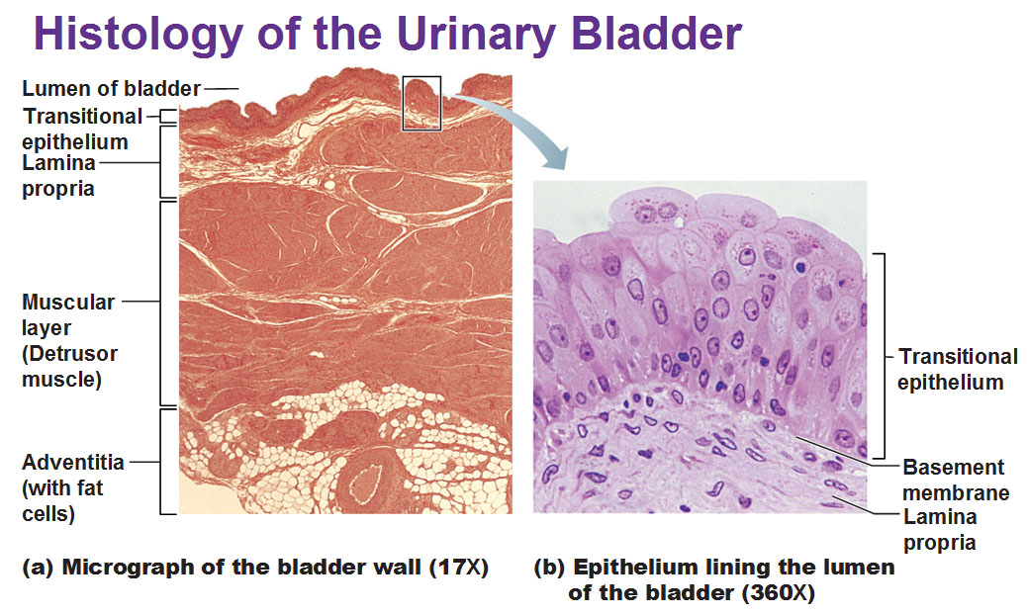
Notes:
Histology of urinary system

Slide 30
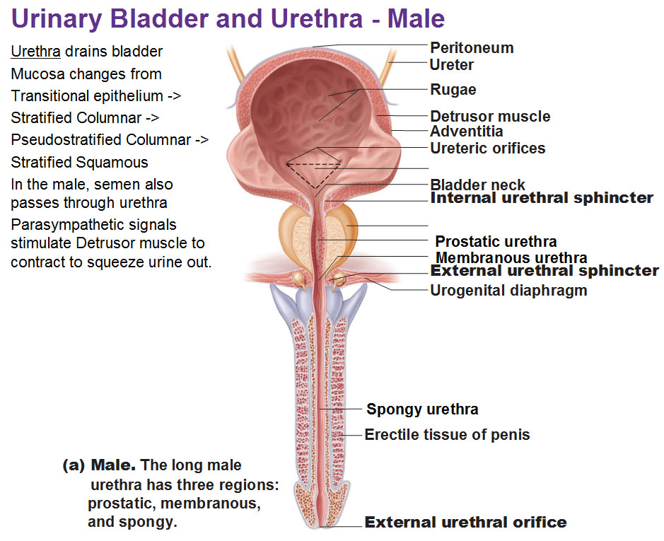
Urethra
Fibromuscular tube.
Carries the urine to exterior.
Its mucosa has large longitudinal folds.
In the male:
Prostatic part: lined by urothelium.
Membranous part: lined by stratified columnar at beginning and pseudostratified epithelium at end.
Spongy part: lined by stratified columnar, pseudostratifiied columnar and stratified squamous more distally.
In female:
Lined firstly by transitional EPI, then stratified squamous EPI with some pseudostratifiied in some areas.

Slide 31
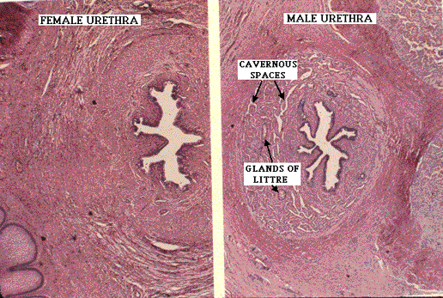
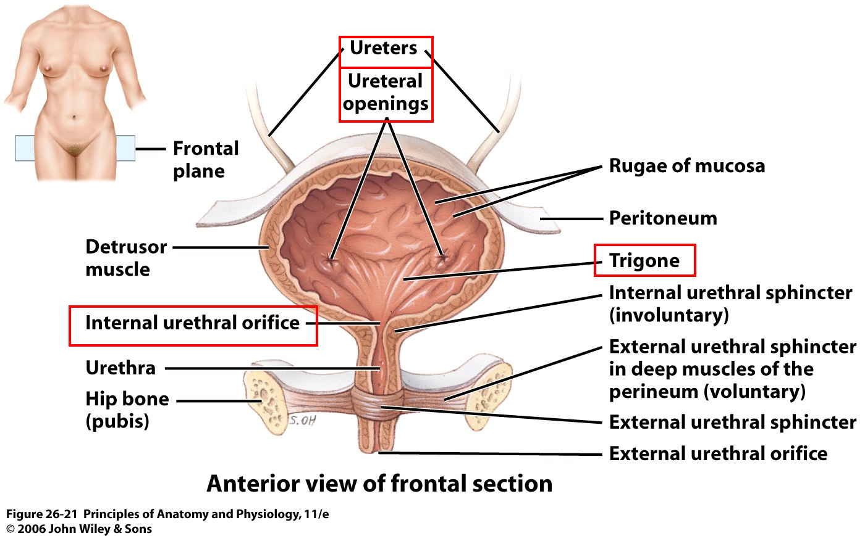

Slide 32
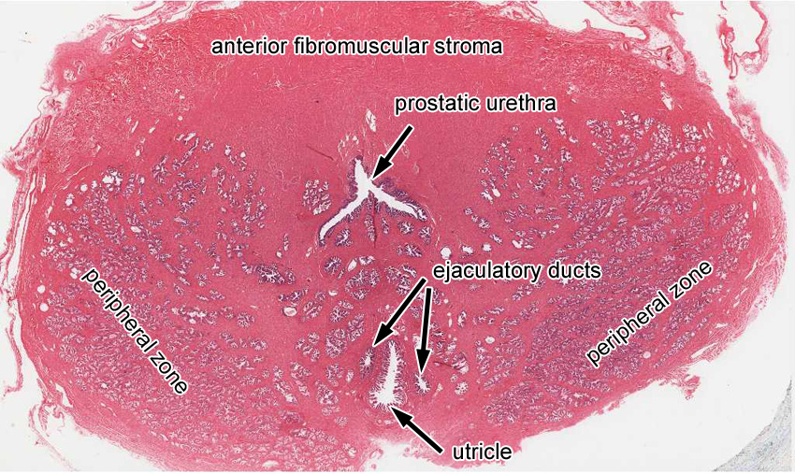
Male urethra

Slide 33
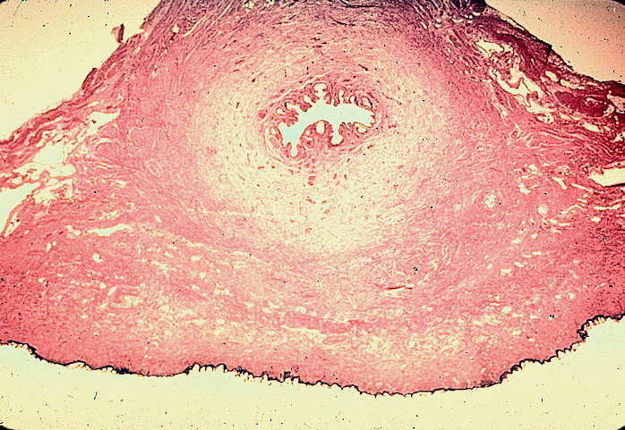
Female urethra

Slide 34
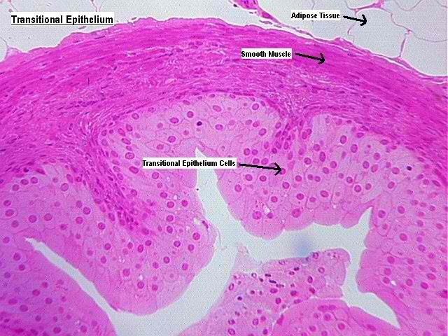
Urothelium
Transitional EPI.
Composed of 3 layers:
Basal layer: single small cells rest on thin basement membrane.
Intermediate layer: more than one layers of more columnar cells.
Superficial layer: large, polyhedral, bi or multinucleated cells. protect underlying cells against cytotoxic effects of urine.

Slide 35
thanks

